Slide 1

Beyond string-based logging
Structured-logging with Serilog
Thibaud DESODT
@tsimbalar

Slide 2
log.info("Home page for customer %s loaded in %d ms", customerName, duration)
2012-12-12 11:51:11,332 [main] INFO: App is starting
2012-12-12 11:56:19,643 [Cart] INFO: Customer john@doe.com added 5 items to the cart
2012-12-12 11:56:19,902 [Home] INFO: Home page for customer john@doe.com loaded in 3 ms
2012-12-12 11:57:32,042 [Cart] INFO: Customer john@doe.com added 1 items to the cart
2012-12-12 11:58:17,902 [Home] INFO: Home page for customer paul.smith@gmail.com loaded in 1 ms
2012-12-12 11:59:13,631 [Cart] INFO: Customer paul.smith@gmail.com added 1 items to the cart
2012-12-12 11:59:43,902 [Home] INFO: Home page for customer paul.smith@gmail.com loaded in 4 ms

Slide 3
log.info("Home page for customer %s loaded in %d ms", customerName, duration)
2012-12-12 11:51:11,332 [main] INFO: App is starting
2012-12-12 11:56:19,643 [Cart] INFO: Customer john@doe.com added 5 items to the cart
2012-12-12 11:56:19,902 [Home] INFO: Home page for customer john@doe.com loaded in 3 ms
2012-12-12 11:57:32,042 [Cart] INFO: Customer john@doe.com added 1 items to the cart
2012-12-12 11:58:17,902 [Home] INFO: Home page for customer paul.smith@gmail.com loaded in 1 ms
2012-12-12 11:59:13,631 [Cart] INFO: Customer paul.smith@gmail.com added 1 items to the cart
2012-12-12 11:59:43,902 [Home] INFO: Home page for customer paul.smith@gmail.com loaded in 4 ms
Can you tell me the customers for which the home page took >3 ms to load today, please ?

Slide 4
Text-based logging
Write log messages
Structured-logging
Write log events
2012-12-12 11:56:19,902 [Home] INFO: Home page for customer john@doe.com loaded in 3 ms
timestamp : "2012-12-12 11:56:19,902"
level : "Information"
module : "Home"
msg : "Home page for customer %s loaded in %d ms"
customerName : "john@doe.com"
duration : "3"

Slide 5
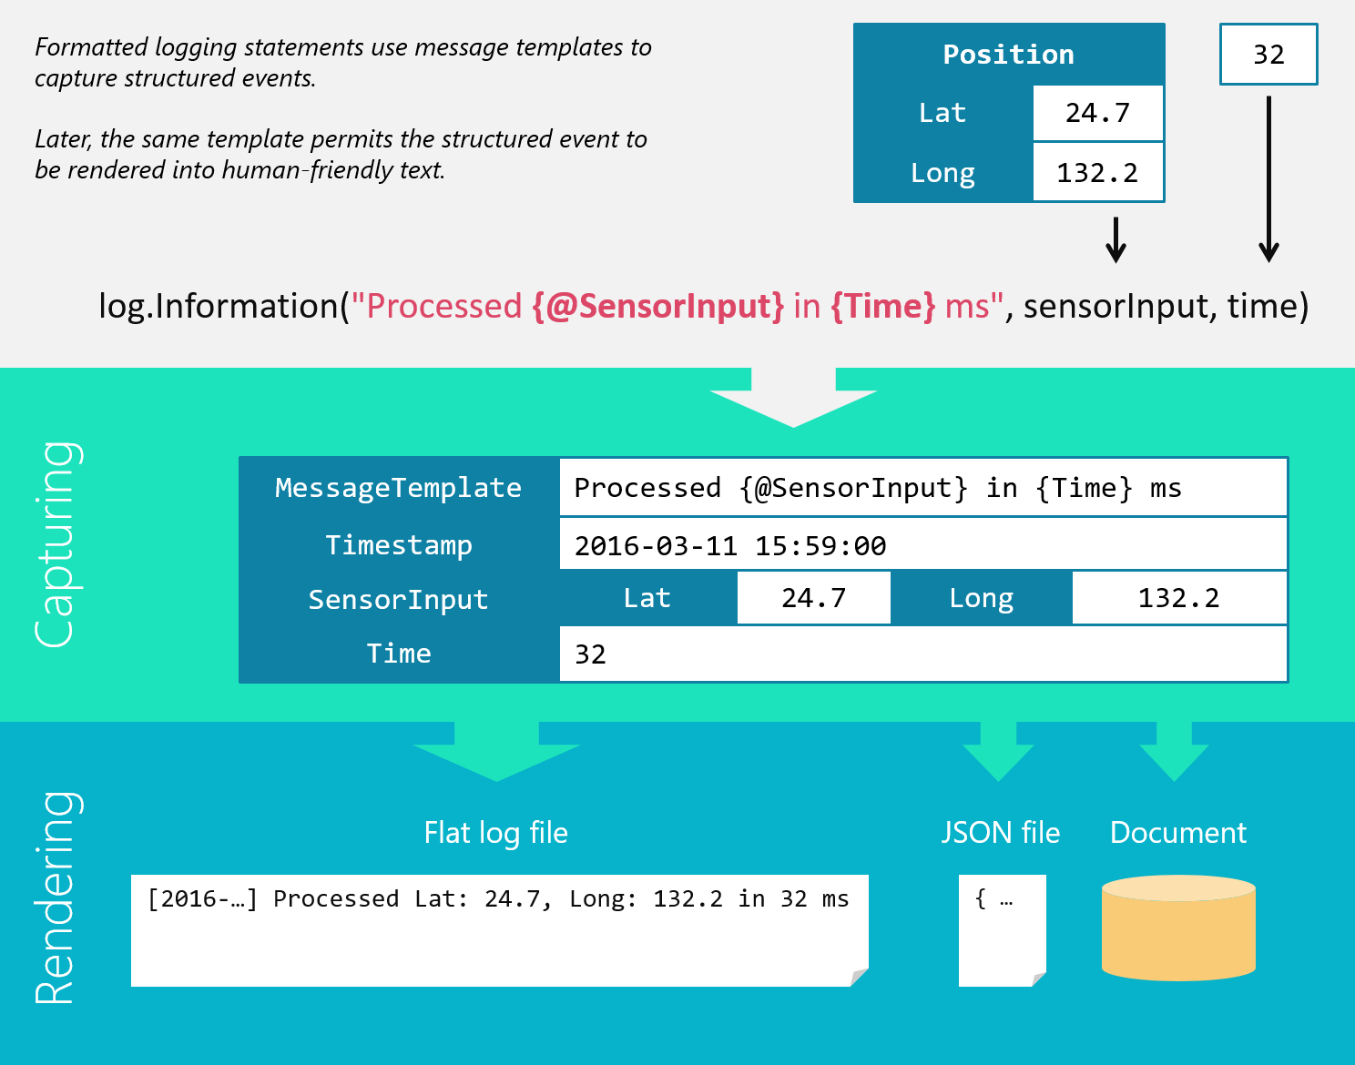

Slide 9
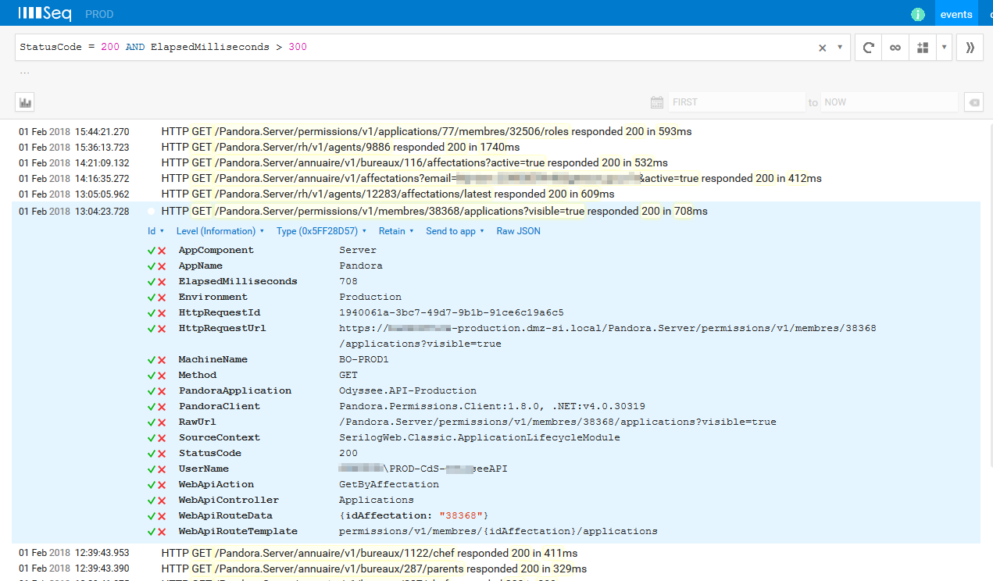

Slide 11
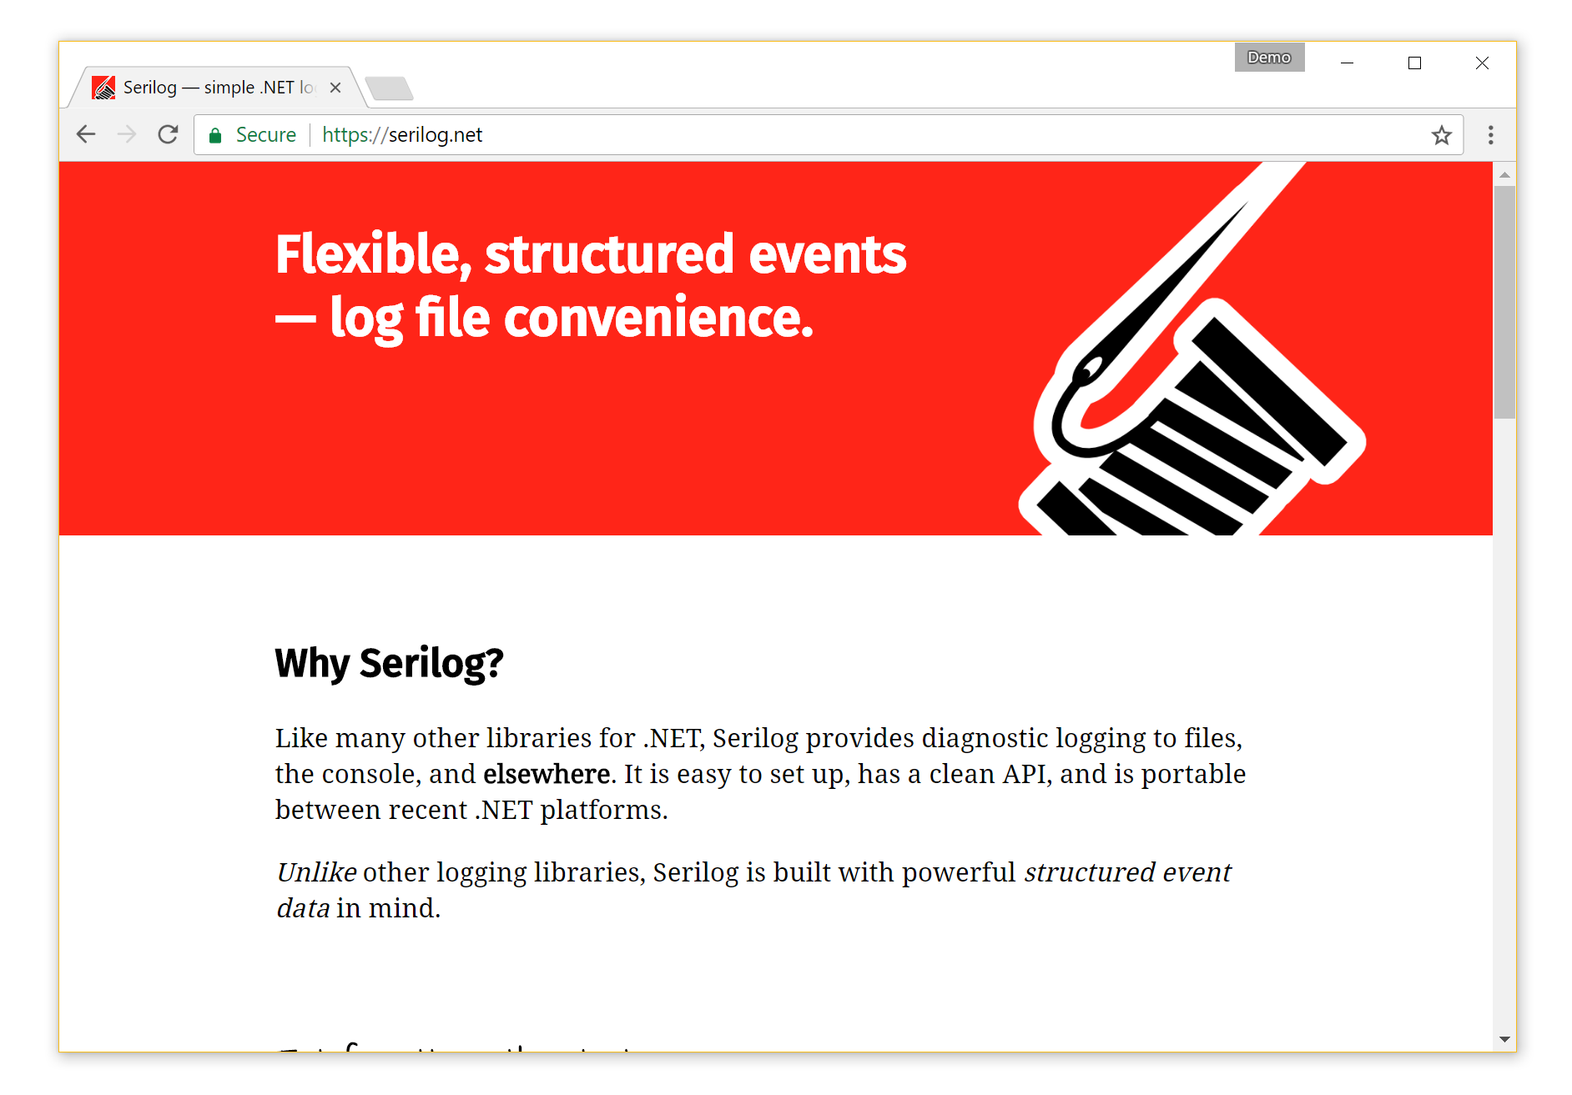
About Serilog
OSS/Apache 2.0 License
.NET Framework & Core
4 years active development
2.5M+ package downloads
80+ contributors
100+ sinks
Made with
6.7M+
More info :
https://serilog.net
https://github.com/serilog
https://messagetemplates.org/
Thibaud DESODT
@tsimbalar

